Slide 1



E-book Summary Extraction Along With
Sentiment Analysis
P-101 Group 3
Mentors- Kartik & Pallavi
05/04/2022
Team members:
Ishrath Jahaan Didagur
Sarika Walake
Madhav Pawar
Shubham Garje
Mohammed Mubarizuddin
Prathik Mohan
Notes:
‹#›
‹#›
‹#›
‹#›

Slide 2
Business Objective
Notes:
‹#›

Slide 3
Business Objective : Extract the ebook summary, then categorize it’s content as positive, negative or neutral by building/using an NLP model with highest accuracy or compound score.
Notes:
‹#›

Slide 4
Project Architecture
Notes:
‹#›

Slide 5
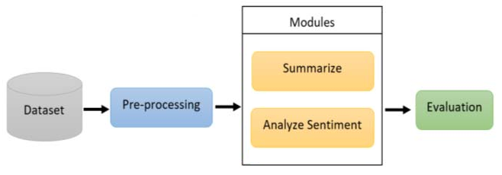


Abstract View of Project Architecture
Powered by:
VADER©
PyPDF
Notes:
‹#›

Slide 6
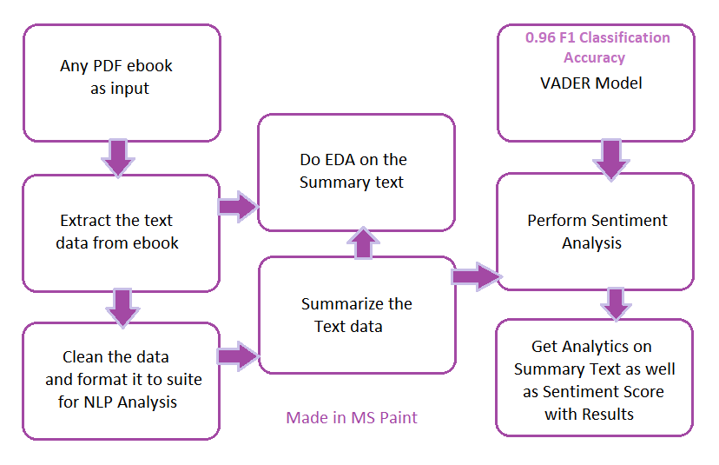
Detailed View of Project Architecture
Notes:
‹#›

Slide 7
Dataset Details &
Data Extraction
Notes:
‹#›

Slide 8
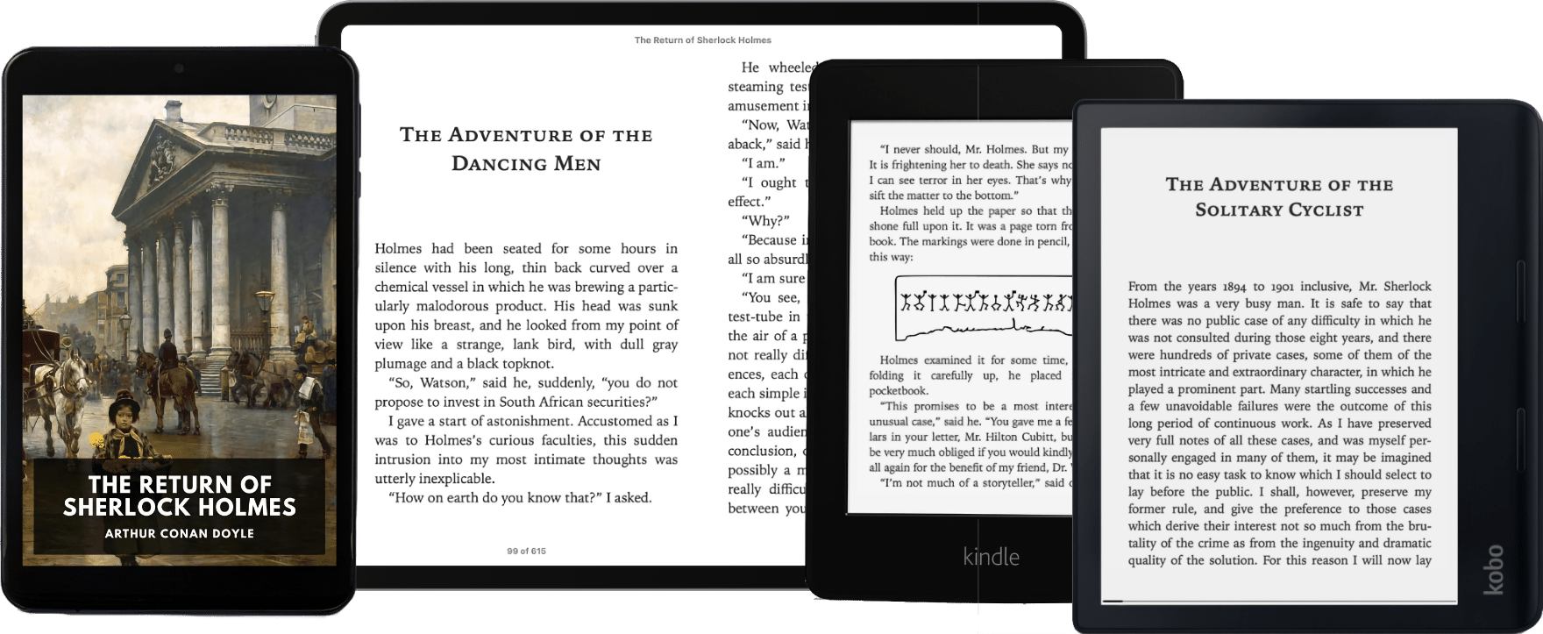
Dataset Details
Any PDF e-book is the input for this project.
We tried 5 different types of PDF ebook genres:
Thriller
Fiction
Self-help
Motivation
Non-Fiction
Notes:
‹#›

Slide 9

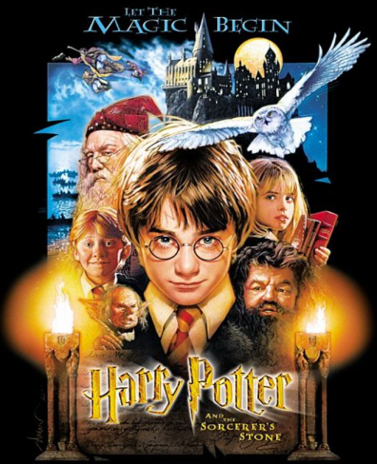

Extracting/Scraping Data from
e-book (PDF)
Input Data is any e-book → Happy Potter Series
Part One e-book → Harry Potter and the Sorcerer's Stone
Goal: Complete HP Series → Extract Summary then
Most e-books in PDF or EPUB
First task → Convert PDF/EPUB to editable information
Framework: PyPDF2
Language: Python 3
Notes:
‹#›
‹#›
‹#›
‹#›

Slide 10
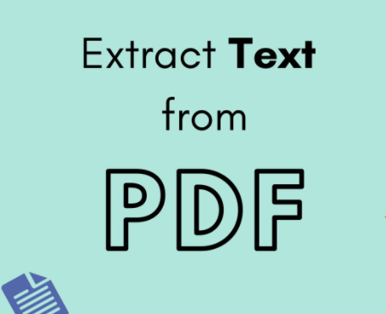
PyPDF2
Pure-python PDF toolkit originating from the pyPdf project currently maintained by Phaseit, Inc.
What can it do?
PyPDF2 can extract data from PDF files, or manipulate existing PDFs to produce a new file. PyPDF2 is compatible with Python versions 2.6, 2.7, and 3.2 - 3.5.
Web: https://pythonhosted.org/PyPDF2/
!pip install PyPDF2
import PyPDF2 as pdf
Class: PdfFileReader
Notes:
‹#›
‹#›
‹#›
‹#›

Slide 11
Featuring Engineering/Cleaning and Formatting of Data
Notes:
‹#›

Slide 12
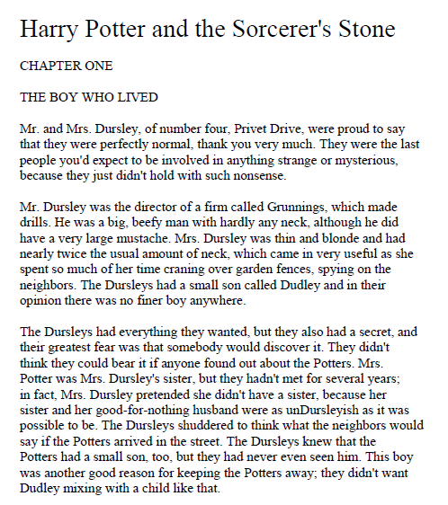
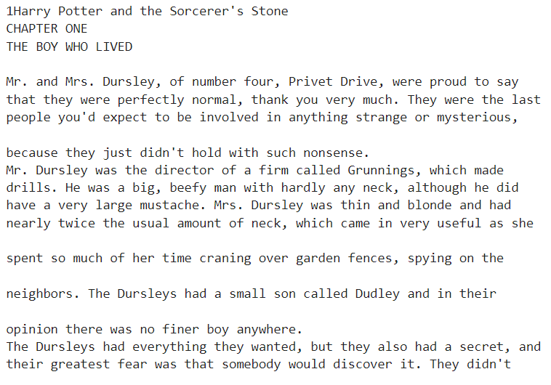
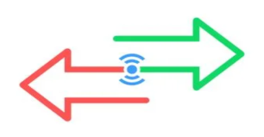
Part 1 - Sample Text Extraction Result
Harry Potter and the Sorcerer's Stone e-book Page 02
Notes:
‹#›
‹#›
‹#›
‹#›

Slide 13
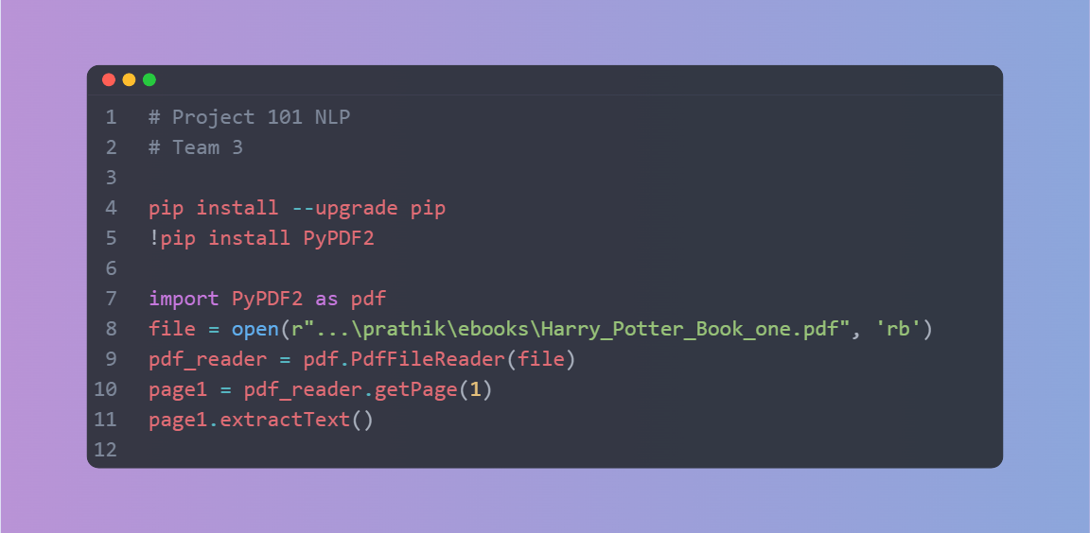
Sample Extraction Code Snippet
Notes:
‹#›
‹#›
‹#›
‹#›

Slide 14
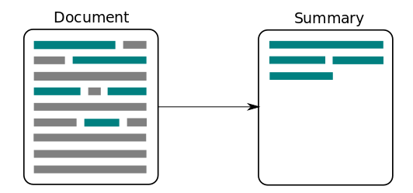
Part 2 – Clean and Summarize the Input information
Cleaning → Involves – removing unwanted characters, encoding in proper format, tokenization (splitting string into words or sentences), removing stop-words & punctuation etc.
Why Cleaning? preparing text for NLP.
Summarization → Picking only important info from complete information
Why Summarization? Makes selection process easier, increases chance to process multiple books at once for NLP etc.
Notes:
‹#›
‹#›
‹#›
‹#›

Slide 15
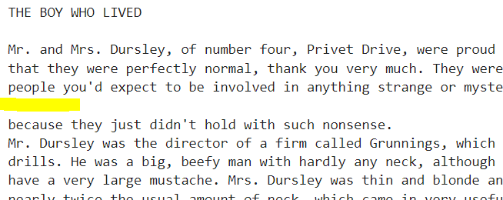
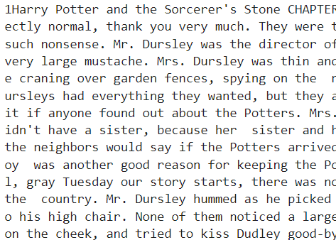
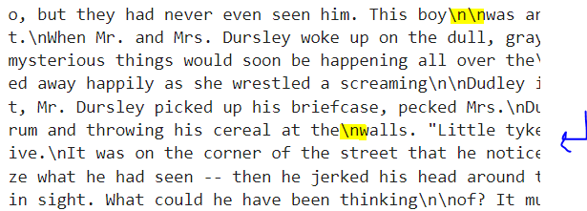
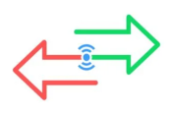
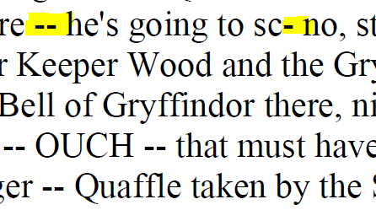
Cleaning Process
Methods used in Python coding:
.split()
.replace()
List to String custom function
Notes:
‹#›
‹#›
‹#›
‹#›

Slide 16
Summarization Process
Notes:
‹#›

Slide 17
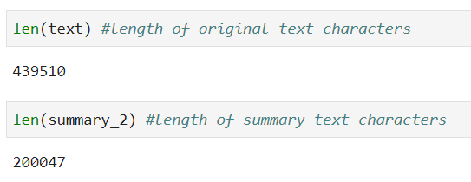
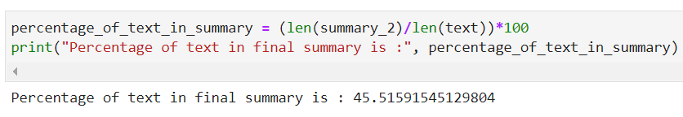
Summarization Process
1. Do word tokenization,
2. Calculate word frequency,
3. Get the normalized word frequencies of each word,
4. Then do sentence tokenization,
give sentence a score based on the normalized word frequency present in each sentence,
5. Finally get 30% of the sentences based on the maximum score (importance) of each sentence.
Libraries/Methods used in Python coding:
nltk, spacy, string, heapq
STOP_WORDS, punctuation
Notes:
‹#›
‹#›
‹#›
‹#›

Slide 18
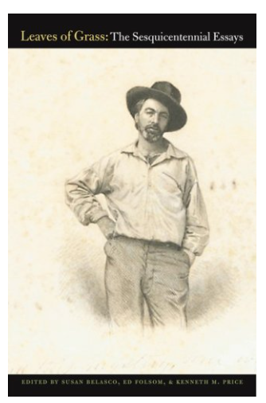
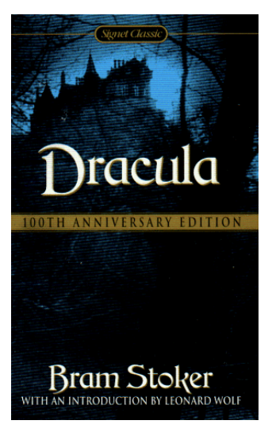
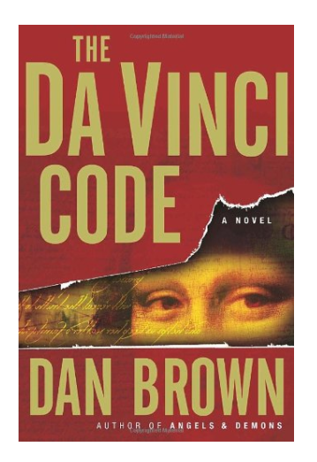
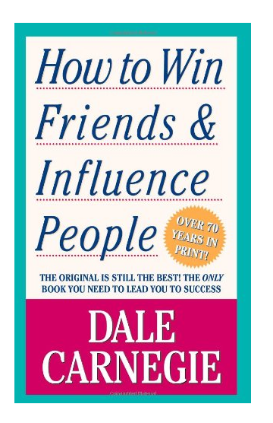
Summarization on 5+ ebook Genres Works:
1 - Fiction > Harry Potter Series (7 ebooks)
2 - Self-help book > How to Win Friends & Influence People
3 - Thriller > The Da Vinci Code
4 - Poetry > Leaves of Grass: The Sesquicentennial Essays
5 - Horror > Dracula
Notes:
‹#›
‹#›
‹#›
‹#›

Slide 19
EDA on Data
Notes:
‹#›

Slide 20
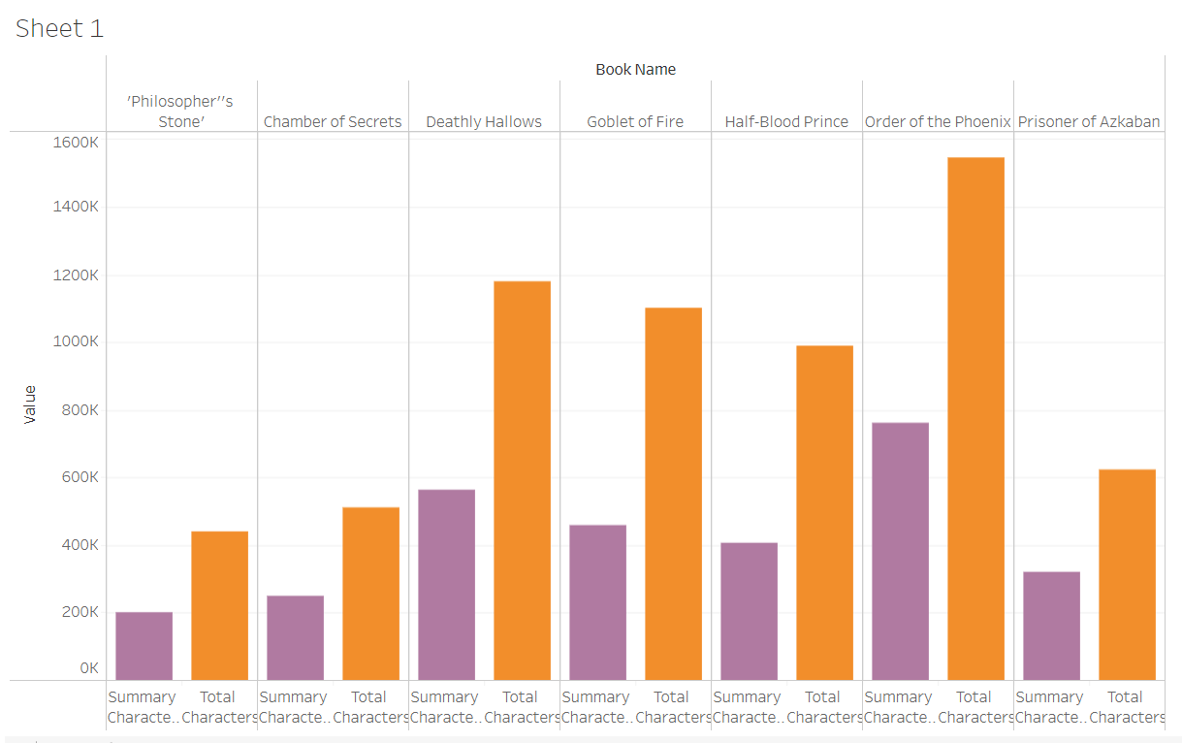
Tableau Public Link (View Full Scale Image): https://public.tableau.com/app/profile/prathikmohan/viz/Harry_NLP_EDA_Summary/EDA_1?publish=yes
EDA on Character Count comparison data:

Slide 21
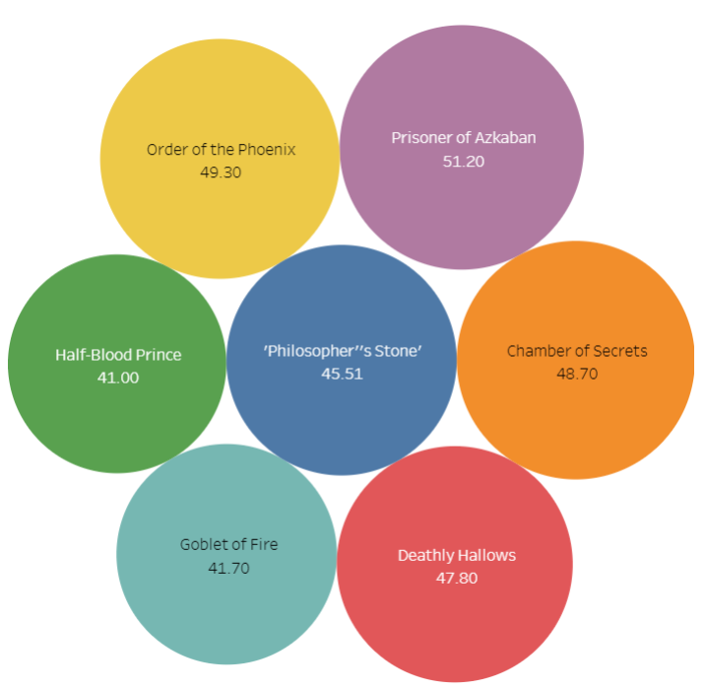
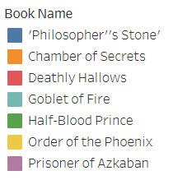
Tableau Public Link (View Full Scale Image): https://public.tableau.com/app/profile/prathikmohan
EDA on Percentage of Characters in Summary
Text:

Slide 22
Summarization Results
Notes:
‹#›

Slide 23
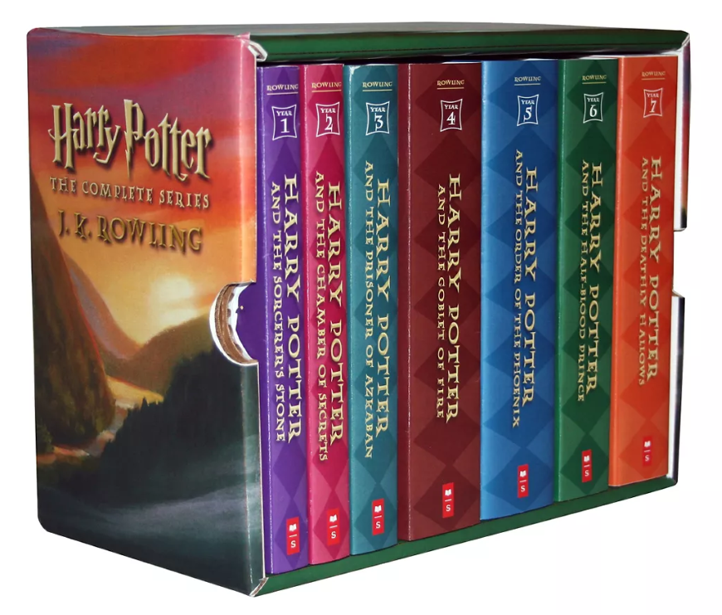
Summarization of all Harry Potter Books
Book 1 - 45.51% of text in Summary, Total charac: 4,39,510, Summary charac: 2,00,047
Book 2 - 48.7% of text in Summary, Total charac: 5,10,738, Summary charac: 2,48,816
Book 3 - 51.2% of text in Summary, Total charac: 6,24,828, Summary charac: 3,20,276
Book 4 - 41.7% of text in Summary, Total charac: 11,02,836, Summary charac: 4,60,399
Book 5 - 49.3% of text in Summary, Total charac: 15,46,514, Summary charac: 7,62,869
Book 6 - 41.0% of text in Summary, Total charac: 9,90,568, Summary charac: 4,06,579
Book 7 - 47.8% of text in Summary, Total charac: 11,77,878, Summary charac: 5,63,767
Notes:
‹#›
‹#›
‹#›
‹#›

Slide 24
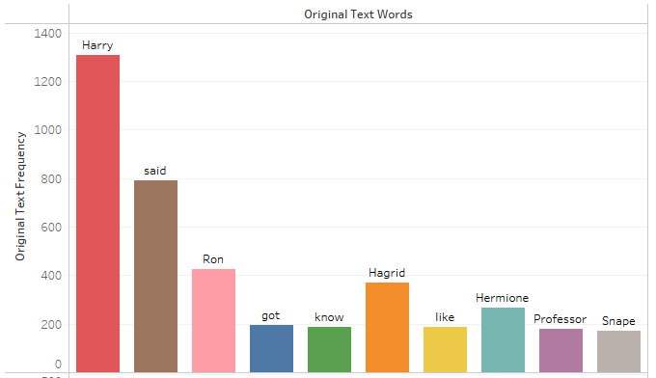
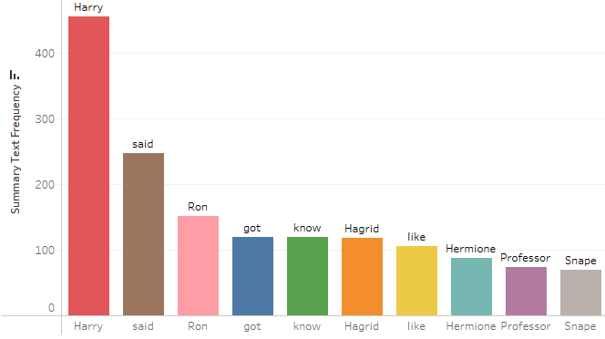
Tableau Public Link (View Full Scale Image): https://public.tableau.com/app/profile/prathikmohan
EDA - Important information retained in both summary and original text
Top 10 Words and their
frequencies in Original Text:
Same Words and their
frequencies in Summary Text:
Thus important information is retained in Summary

Slide 25
Model Building
Notes:
‹#›

Slide 26
Model Building - VADER (Valence Aware Dictionary and Sentiment Reasoner)
What is VADER? Why VADER? How it checks all requirement for us?
What is VADER >
A lexicon and rule-based sentiment analysis package
Open-sourced under the [MIT License].
Available in NLTK package and can be applied directly to unlabeled text data.
Relies on a dictionary that maps lexical features to emotion intensities known as sentiment scores. The sentiment score of a text can be obtained by summing up the intensity of each word in the text.
Understands basic context of words.
Understands the emphasis of capitalization and punctuation
Can predict emotions
Notes:
‹#›
‹#›
‹#›
‹#›

Slide 27
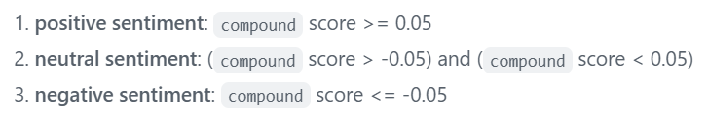
Model Details - VADER (Valence Aware Dictionary and Sentiment Reasoner)
Why VADER? and How it ticks all requirements for us?
Our requirement >
We are looking for Unsupervised algorithm/model because our data is RAW extracted from textbook or ebook with no labels. We do not have pre built .csv.
Based on study, VADER performs as good as individual human readers at matching ground truth.
Model has good F1 accuracy of 0.96 vs human accuracy 0.84
Has compound score as metric for accuracy- most commonly used for sentiment analysis by most researchers, including the authors. Eg: Harvard, University of Colorado Boulder etc.
Notes:
‹#›
‹#›
‹#›
‹#›

Slide 28
Model Results
Notes:
‹#›

Slide 29
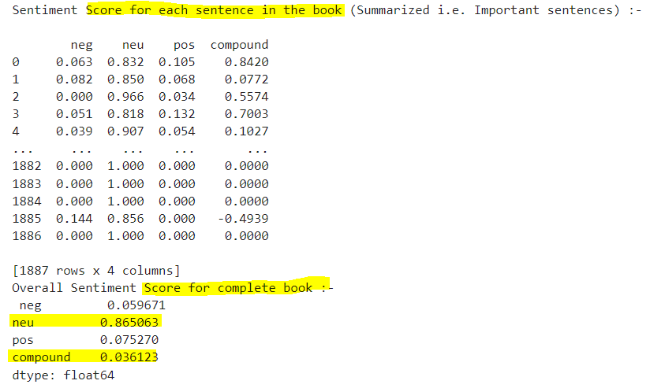
Model Results - Sentiment Analyzer on Harry Potter First Book Summary text:
Model has
0.96 F1 Classification Accuracy
Notes:
‹#›
‹#›
‹#›
‹#›

Slide 30
Model Deployment
Notes:
‹#›

Slide 31
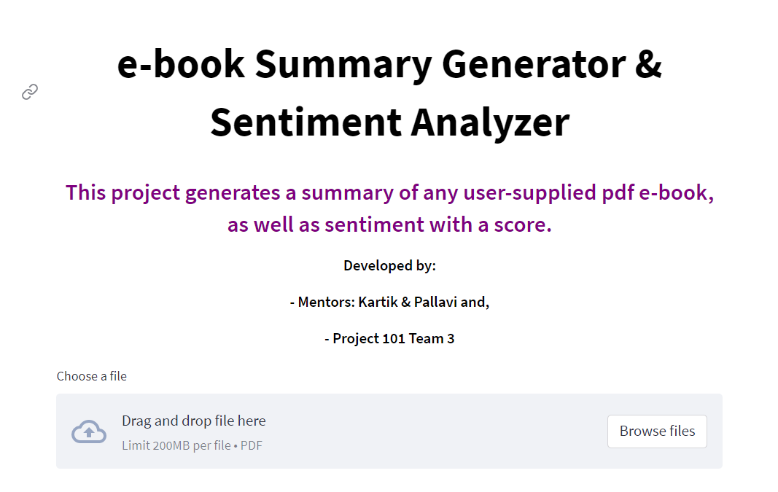
Model Deployment in Streamlit:
Notes:
‹#›
‹#›
‹#›
‹#›

Slide 32
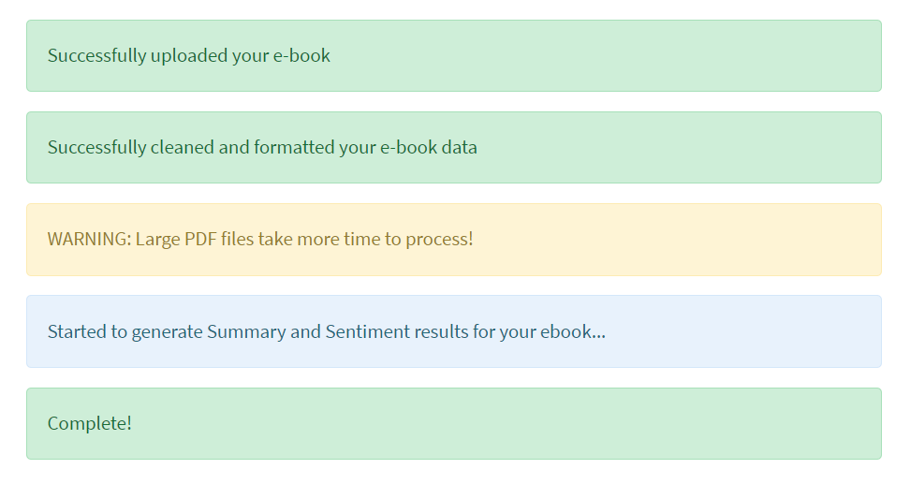
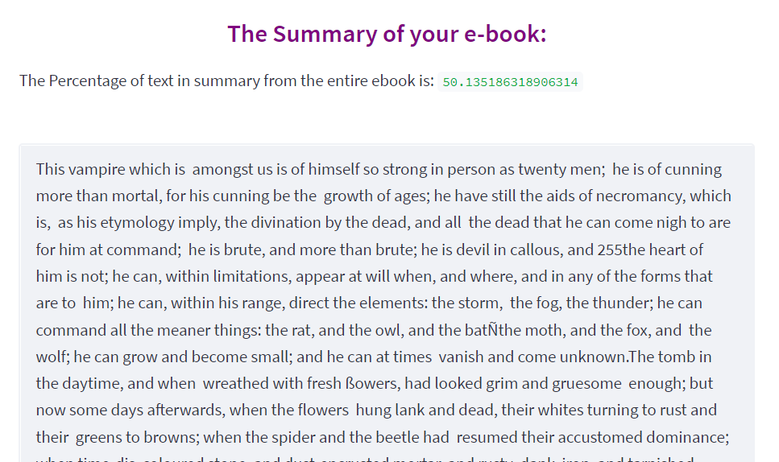
Model Deployment in Streamlit:
Notes:
‹#›
‹#›
‹#›
‹#›

Slide 33
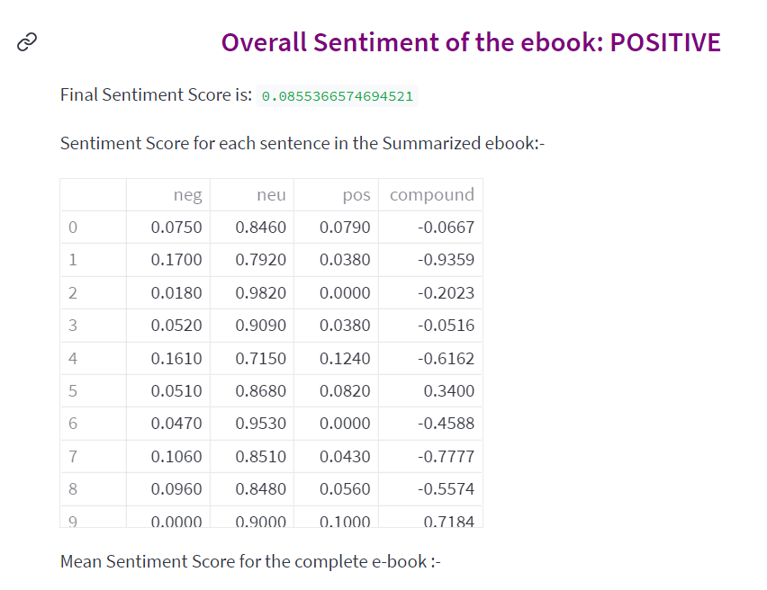
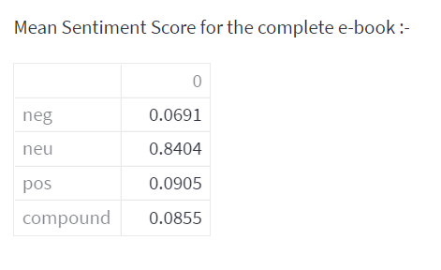
Model Deployment in Streamlit:
Notes:
‹#›
‹#›
‹#›
‹#›

Slide 34
Challenges Faced
Uploading of PDF file and reading as RAW String Literal in Streamlit
Converting PDF text object to Binary Formatted input in Streamlit
Initial attempt to deploy in Flask was unsuccessful. HTML was challenging.
How did you overcome?
Streamlit Forums provided a lot of help:
For issue on RAW String: Use ‘\’ in place of r‘/’.
For issue on Binary Formatted input > Streamlit engine does the job by itself
Streamlit was used as an option to deploy the model.
Notes:
‹#›
‹#›
‹#›
‹#›

Slide 35
Thank you
Notes:
‹#›

